Slide 1


SAP UI5 & FIORI with OData TRAINING
Anubhav Oberoy
Day – 15

Slide 2

Agenda – Day 15
Implementing Create in the UI
Implementing Upadte in UI
Implementing Delete uisng UI
Calling Function Import form the UI
Introduction to GitHub
Creating a Git Repository in GitHub.

Slide 3
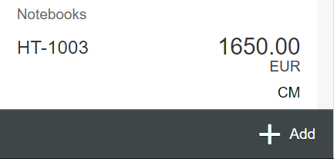
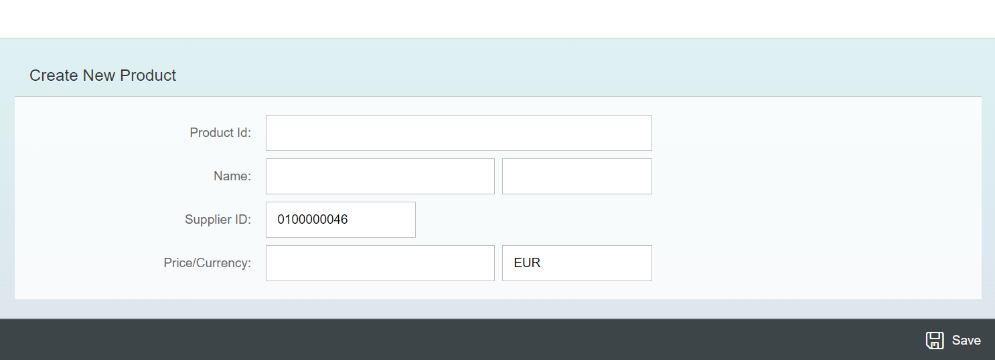
Exercise - Implement Create using UI
Now we will implement create operation in the UI. To do that we need to add a new screen in our application. In that screen we will add a simple form to fill the details of the product and a Save button in the footer of that page.
For this have to a new Add button in the footer of the View1 and on press of that button we will navigate to the new Add View.
Exercise code/resource:
View1.view.xml
View1.controller.js
Add.view.xml
Add.controller.js
manifest.json

Slide 5

Exercise – Implementing Update and Delete
Now we want to Update and Delete the selected record form the backend. To do that we will load the data of the record. Once the data is loaded to update and delete the data, we will add two buttons in the footer of the view named as Save and Delete. We will also add a clear button to clear the data of form.
On entering the Product ID of the product in the Input field and press enter we will load the data of that product in the Form.
Exercise code/resource:
Add.view.xml
Add.controller.js

Slide 7
Exercise – Using Function Import from UI
Now we want to Call the function import form the UI. To do that we will add a button near the Product Id input field. On press of that button, we will load the most expensive product in the form.
Exercise code/resource:
Add.view.xml
Add.controller.js

Slide 8

End of Day 15

Slide 9

Questions

Slide 10

Anubhav Oberoy

Slide 11


We’re committed to empower you to be
Most Desirable Resource
through powerful training solutions.
We build the workforce of the future.
250+
Corporate Clients
30,000+
Learners Trained
25000+
Learners Placed
FREE WEBINARS
Sign up for free webinars with industry experts every fortnight!
Enroll Now!
Contact us today!
https://anubhavtrainings.com/

Slide 12




More from AnubhavTrainings.com

Slide 13
Title
Content

